Slide 1
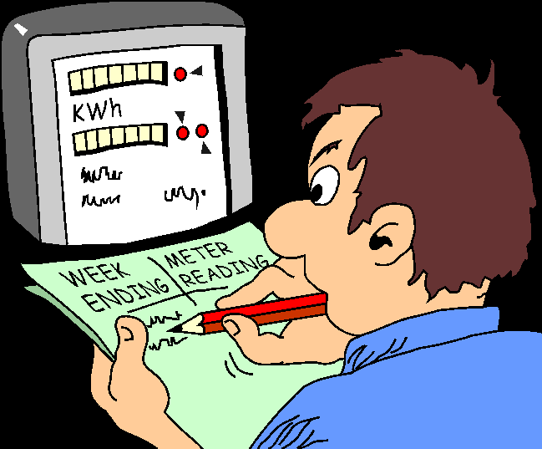
Guidelines for Data Collection
Larissa Schneider Guilhon
University of Canberra

Slide 2
. Steps to Data Collection and Entry:
1) Create your data dictionary.
BEFORE any data is collected.
2) Create your data file(s).

Slide 3
Data Dictionary
A document that includes a description of the study variables and data management procedures.
For each variable, it includes the:
variable name,
role of the variable (in the statistical analysis),
variable label,
unit of measurement (if applicable),
type of variable.
Should be created before any data are collected.
Expect revisions and review with your statistician.

Slide 4
Variable name: used to identify the variable in the data file(s).
Should be short but understandable/self-explanatory.
Variable label: “Pretty" label to fully describe the variable.
Example: “Age at baseline".
Type of variable:
Continuous: has any number of possible values (eg, weight).
Discrete numeric: set of possible values is a finite (ordered) sequence of numbers (eg, pain scale of 1, 2, . . . , 10).
Categorical: has only certain possible values (eg, race).
Binary (dichotomous) : a categorical variable with only two possible values (eg, gender).
Ordinal : a categorical variable for which there is a definite ordering of the categories (eg, severity of lower back pain as none, mild, moderate, and severe).

Slide 5
Additional considerations
Continuous variables: Keep continuous, don't categorize.
If collected categorized, original continuous values can't be recovered and can't recode with new categories.
Be consistent with text coding of categorical variables : many statistical programs are case-sensitive (eg, “M" ǂ “m").
Date formats (eg, mm/dd/yyyy).
Representation of missing values (eg, blank or NA).

Slide 6
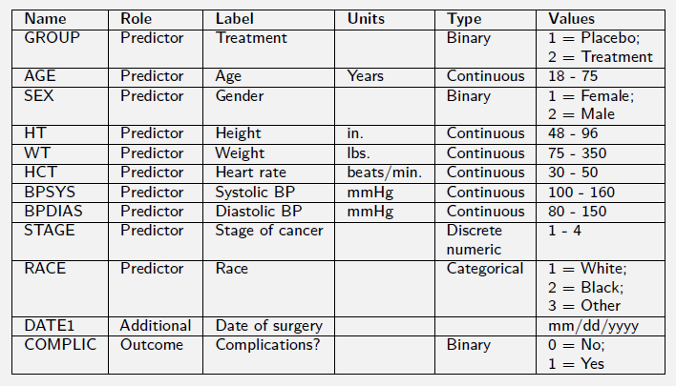
Data Dictionary

Slide 7
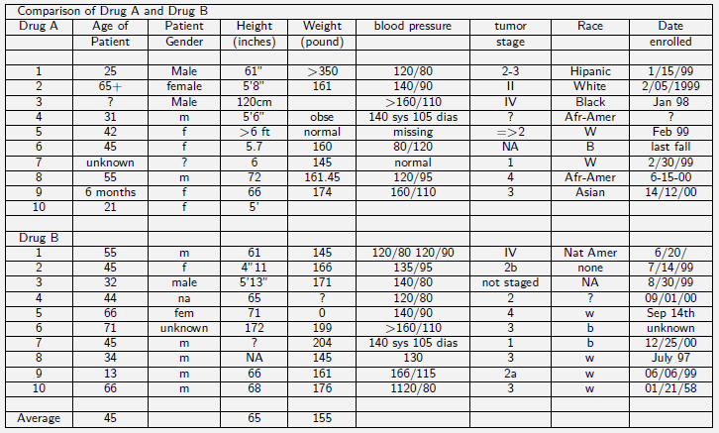
Spreadsheet from Hell

Slide 8
Data Entry Guidelines
Data structure for repeated measurements on the same subject (or unit of analysis).
Example: A study where 5 weekly blood pressure readings are made on each of 20 subjects.
Two options: a “wide" data file or a “long" data file.
“Wide": 20 rows and 6 columns (5 blood pressures and an ID).
Still have one record (row) per subject.
“Long": 100 rows of 3 columns (ID, week number (1-5), and blood pressure)).
Have 5 records (rows) per subject.
Which option to use will depend on the target statistical program.

Slide 9
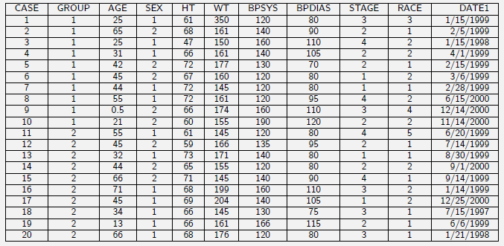
Spreadsheet from Heaven

Slide 10
Data collection at Postgrad BBQ
Mighty Soft Bread Rolls Hamburger Buns | 15
Woolworths Select Mixed Grain Sandwich Bread | 6
Woolworths Select Wholemeal Sandwich Vitamins & Iron | 6
Masterfoods Barbecue Sauce Honey | 2
Masterfoods Mustard Honey Squeezy | 2
Masterfoods Tomato Sauce Australian Grown | 2
Homebrand Iodised Salt Drum | 1
Red Island Australian Extra Virgin Cold Pressed Olive Oil | 1
Woolworths Select Pepper Black Cracked | 1
Woolworths Select Margarine Spread Olive Oil | 2
Coca Cola Bottle | 8
Golden Circle Orange Fruit Juice | 4
Golden Circle Pine Orange Fruit Juice | 4
Schweppes Lemonade Bottle | 5
Fresh Cuts Salad Mix Baby Leaf With Beetroot | 7
Chinet Cutlery Plastic Forks | 8
Chinet Cutlery Plastic Knives | 8
Deeko Serving Entertainer Plastic Plates | 10
Homebrand Serviettes Plain | 5
Homebrand Serving Disposable Teaspoons | 15

Slide 11
Mighty Soft Bread Rolls Hamburger Buns | 15
Woolworths Select Mixed Grain Sandwich Bread | 6
Woolworths Select Wholemeal Sandwich Vitamins & Iron | 6
Masterfoods Barbecue Sauce Honey | 2
Masterfoods Mustard Honey Squeezy | 2
Masterfoods Tomato Sauce Australian Grown | 2
Homebrand Iodised Salt Drum | 1
Red Island Australian Extra Virgin Cold Pressed Olive Oil | 1
Woolworths Select Pepper Black Cracked | 1
Woolworths Select Margarine Spread Olive Oil | 2
Coca Cola Bottle | 8
Golden Circle Orange Fruit Juice | 4
Golden Circle Pine Orange Fruit Juice | 4
Schweppes Lemonade Bottle | 5
Fresh Cuts Salad Mix Baby Leaf With Beetroot | 7
Chinet Cutlery Plastic Forks | 8
Chinet Cutlery Plastic Knives | 8
Deeko Serving Entertainer Plastic Plates | 10
Homebrand Serviettes Plain | 5
Homebrand Serving Disposable Teaspoons | 15

